Slide 1
Wait-Less
Group 20: Spancer Guo, Jiajie Lin, Hongcheng Wu, Zachary Flebbe

Slide 2
What is Wait-Less?
Wait-Less is a restaurant management application that will increase servers and hosts work efficiency as well as help the manager/owner to manage the restaurant.
This application contains three modes:
Host Mode
Server Mode
Manager Mode

Slide 3
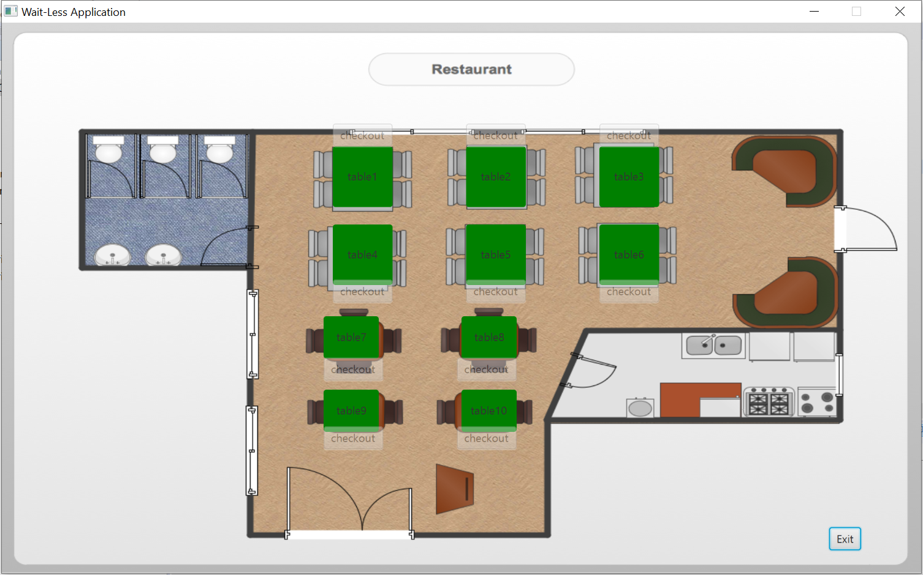
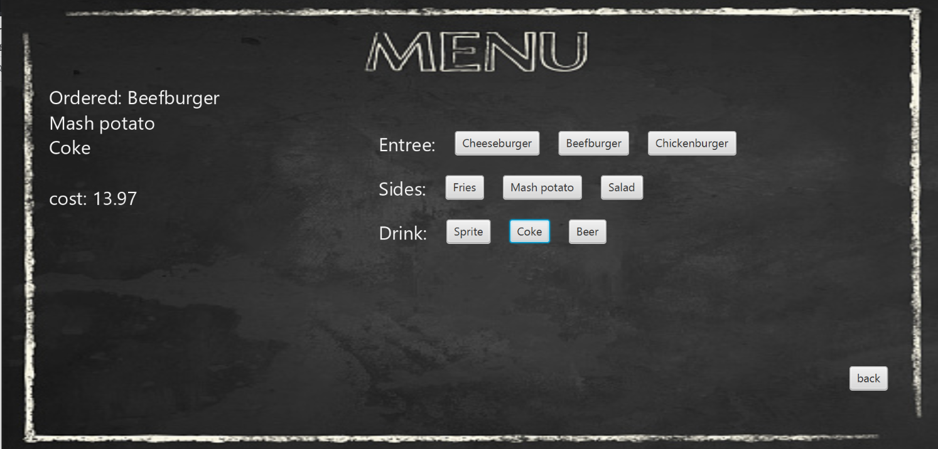
Server Mode
Order
clickable table buttons
automatic price calculations
Check out
print out total cost of table’s tab
change table status to available

Slide 4
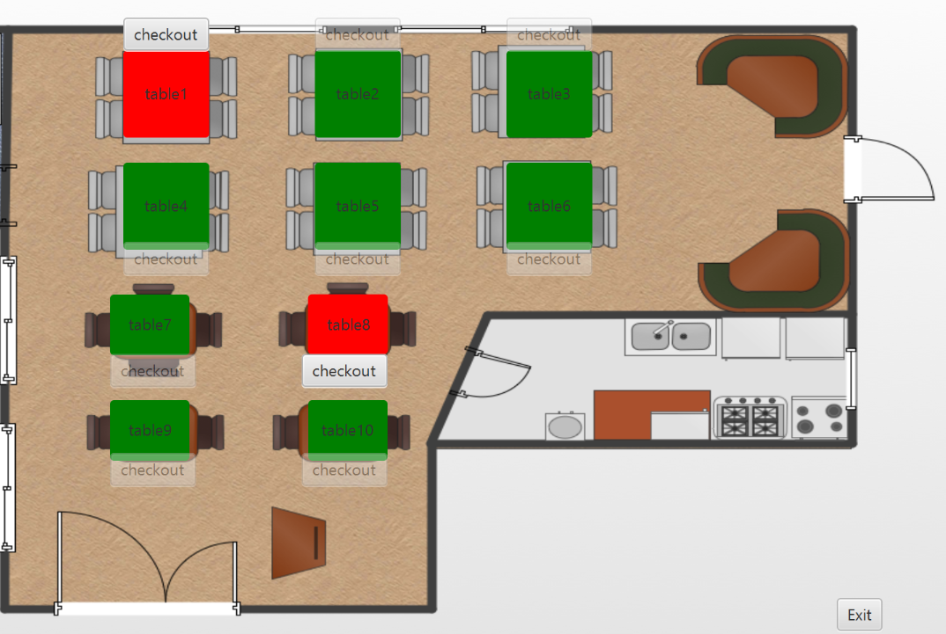
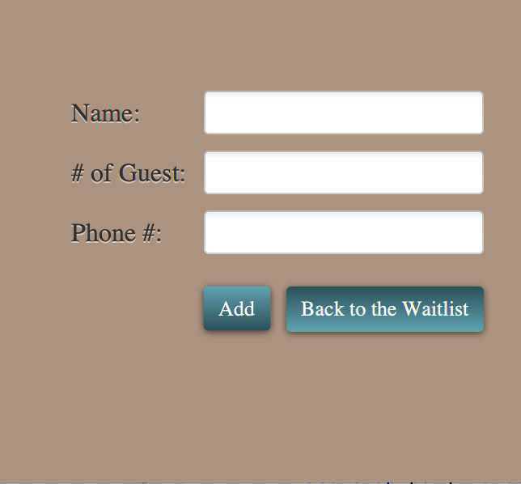
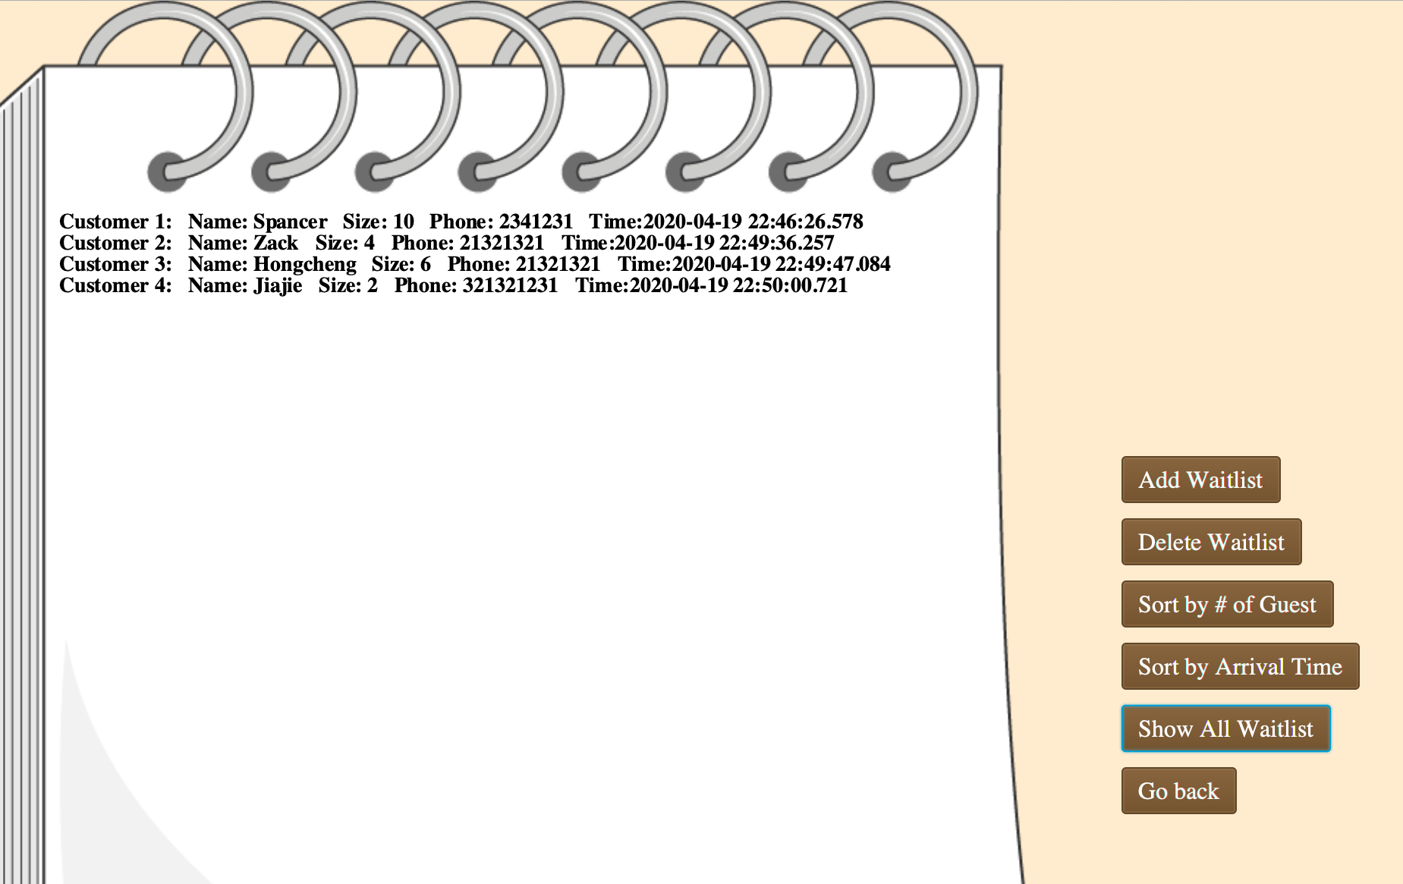
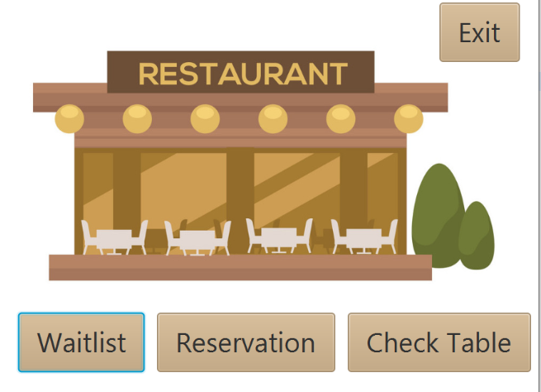
Host Mode
Waitlist & Reservation
Add reservation/waitlist
Delete reservation/waitlist
Sort current waitlist by time/size
Check Table
Will show all the tables in restaurant

Slide 5
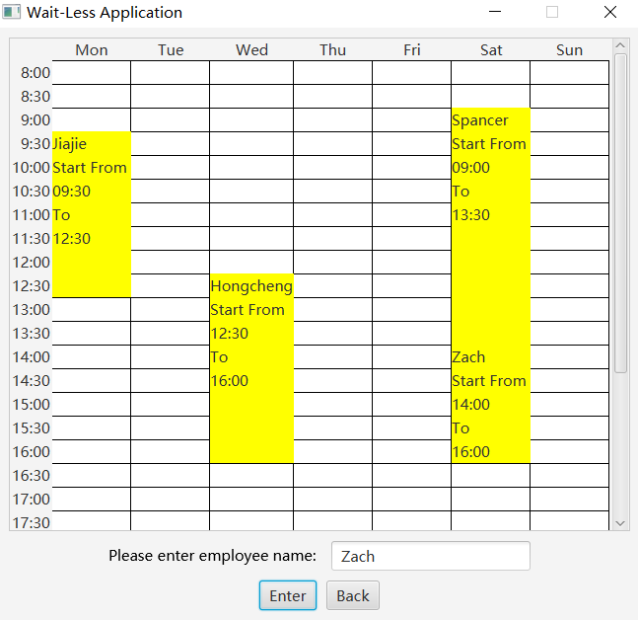
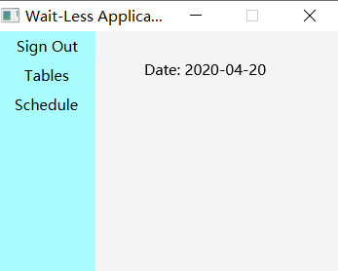
Manager Mode
Plan schedule
Making schedule for very employees
Check tables

